Slide 1
UNIT -2
SHORT CIRCUIT ANALYSIS

Slide 2
Basic Units
The 4 basic electrical quantities are
Voltage V (volt)
Current I (amp)
Impedance Z (ohm)
Power S (VA)
For single-phase circuits
V(volt) = Z(ohm) × I(amp);
S (VA) = V(volt) × I(amp)*

Slide 3
Per unit notation
In per unit notation, the physical quantity is
expressed as a fraction of the reference
value, i.e.
per unit value = actual value/base value in
the same unit.
e.g. V(in per unit) = V(in kV)/V base (in kV)
where the base value is a reference value for
magnitude.

Slide 4
Base Quantities
In per unit notation we would like to keep
the basic relations:
Vpu = Zpu Ipu; Spu = Vpu Ipu*
Hence the base quantities should be chosen
such that
Base voltage (VB) = base impedance (ZB) × base current (IB)
Base power (SB) = base voltage (VB) × base current(IB)

Slide 5
Base Quantities
It is common practice to specify base power (SB) and base voltage (VB)
Then it follows
base current IB = SB/VB
base impedance ZB = VB/IB

Slide 6
Percentage Values
An equivalent way to express the per unit
value is the percentage value where
Percentage value = per unit value × 100%

Slide 7
Base Value for 3-phase systems
For 3-phase systems it is common practice
to describe system operation with:
total 3-phase power S = S3-Ø
line voltage V = Vline
line current I = Iline
equivalent impedance/phase Z = Zph
with (in magnitude)
V = √3ZI; S = √3VI

Slide 8
Base Value for 3-phase systems
per unit=actual value/base value
Let KVAb=Base KVA
kVb=Base voltage
Zb=Base impedance in Ω

Slide 9
Changing the base of per unit quantities
Let z = actual impedance(Ω)
= base impedance (Ω)

Slide 10
Changing the base of per unit quantities

Slide 11
Advantages of Per Unit System
Normally we are dealing with numerics near unity rather than over a wide range.
Provides a more meaningful comparison of parameters of machines with different ratings.
As the per unit values of parameters of a machine of a given design normally falls within a certain range, a typical value can be used if such parameters are not provided.

Slide 12
Symmetrical Fault Analysis
One or two phases are involved Voltages and currents become unbalanced and each phase is to be treated individually
The various types of faults are
Shunt type faults
1.Line to Ground fault (LG)
2. Line to Line fault (LL)
3. Line to Line to Ground fault (LLG)

Slide 13
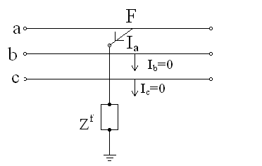
Single Line To Ground Fault
Consider a fault between phase a and ground through an impedance z_{f}

Slide 14
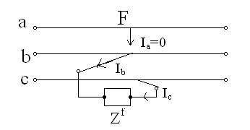
Line To Line (LL) Fault
Consider a fault between phase b and c through an impedance z_{f}

Slide 15
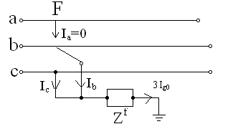
Double Line To Ground (LLG) Fault
Consider a fault between phase b and c through an impedance z_{f} to ground

Slide 16
Fundamentals Of Symmetrical Components
Symmetrical components can be used to transform
three phase unbalanced voltages and currents to
balanced voltages and currents
Three phase unbalanced phasors can be resolved into
following three sequences
1.Positive sequence components
2. Negative sequence components
3. Zero sequence components

Slide 17
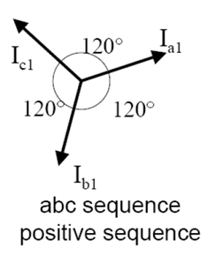
Positive sequence components
Three phasors with equal magnitudes, equally displaced from one another by 120° and phase sequence is same as that of original phasors.

Slide 18
Positive Sequence Phasors

Slide 19
Negative Sequence Phasor

Slide 20
Zero Sequence Phasor

Slide 21
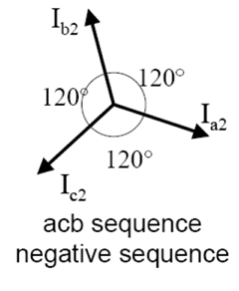
Negative sequence components
Three phasors with equal magnitudes, equally displaced from one another by 120° and phase sequence is opposite to that of original phasors.

Slide 22
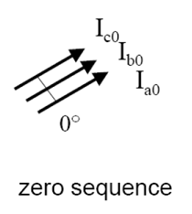
Zero sequence components
Three phasors with equal magnitudes and displaced from one another by 0°.

Slide 23
Relationship Between Unbalanced Vectors And Symmetrical Components

Slide 24
Sequence Impedance
Positive sequence impedance
The impedance of a component when positive sequence currents alone are flowing.
Negative sequence impedance
The impedance of a component when negative sequence currents alone are flowing.
Zero sequence impedance
The impedance of a component when zero sequence currents alone are flowing.

Slide 25
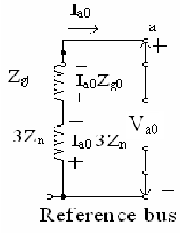
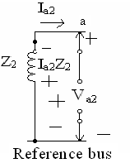
Sequence Networks
Zero sequence network
positive sequence network
negative sequence network

